Slide 1

Prediction of Oil, Gas & Water Production in the DSEATS Field Using Machine Learning
Personnel Details
Organizational Details
Name:
Udoh Chigozie M.
SPE Number:
Category:
Young Professional
Technical Area:
Data Engineering
Section:
Society of Petroleum Engineers Port Harcourt Section
Affiliated Company:
Date:
Friday 12th July, 2024

Slide 2
Outline
Problem Overview
Research on the Problem/Dataset
Brief Introduction to Machine Learning
Types of Machine Learning
Time Series Forecasting
Machine Learning Approach to the Problem
Machine Learning Flow
Data Cleaning
Exploratory Data Analysis (EDA)
Feature Engineering
Data Splitting
Modeling
Hyperparameter Tuning
Model Testing and Selection
Prediction Results

Slide 3
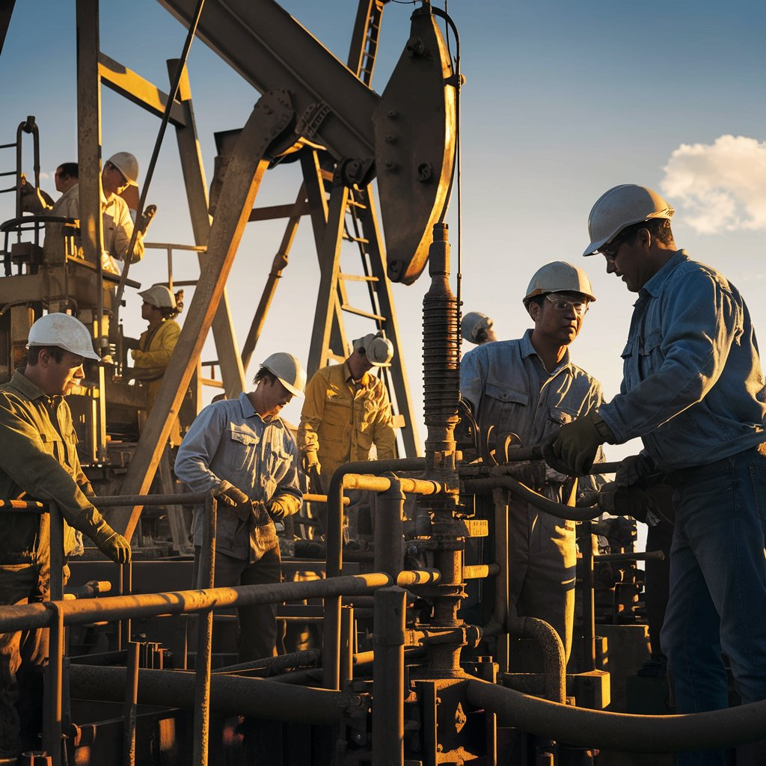
Problem Overview
Accurate forecasting of oil, gas, and water production from an oil well is crucial for optimizing production strategies and ensuring efficient resource management in the oil and gas industry. By analyzing past production data and parameters related to an oil well, the aim was to apply the standard machine learning (ML) workflow to accurately forecast the production profile of oil, gas, and water.
Generated using Ideogram

Slide 4




Research on the Problem/Dataset
Step 2
Study on Oil wells
Impactful Feature Handling
Attained a visual understanding of how oil wells are dug
Summary
A well is drilled and sensors identify hydrocarbon-rich zones. A perforation gun then creates holes, allowing hydrocarbons to flow. A wellhead is installed to control extraction.
Having gained an extensive understanding of the Problem, I was able to think of better ways to use features. E.g.
Removed Outliers based on Gas-Oil Ratio (GOR)
Derived percentage difference of some features in comparison with previous days value (Feature Lagging)
Understanding Features in the Dataset
Gained an understanding of Parameters and how they influence Production. E.g.
Feature | Description
WellBore Name | Name of the bore. Useful for identifying patterns across the different wells.
AVG WHP (PSI) | Flow pressure at the wellhead. This is a relevant feature for oil and gas production.
Step 1
Step 3

Slide 5

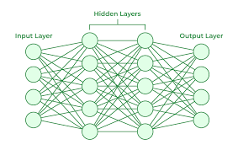
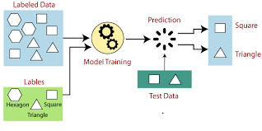

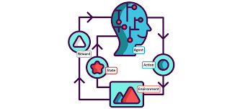
Brief Intro to Machine Learing
Machine learning is a powerful tool that enables computers to learn from data and make predictions or decisions without being explicitly programmed.
a
Subfield (Deep Learning)
1
2
3
Deep Learning is a subset of machine learning that utilizes neural networks with many layers to model and understand complex patterns in data.
Supervised Learning
Unsupervised Learning
Reinforcement Learning
Supervised learning is a machine learning approach where the model is trained on labeled data. It learns to map inputs to outputs based on example input-output pairs.
Unsupervised learning is a type of machine learning that involves training a model on data without labeled responses. This approach allows the model to discover patterns and relationships within the data on its own. It is popularly know as “Clustering”
Reinforcement Learning (RL) is a type of machine learning where an agent learns to make decisions by performing actions and receiving feedback in the form of rewards or penalties.

Slide 6
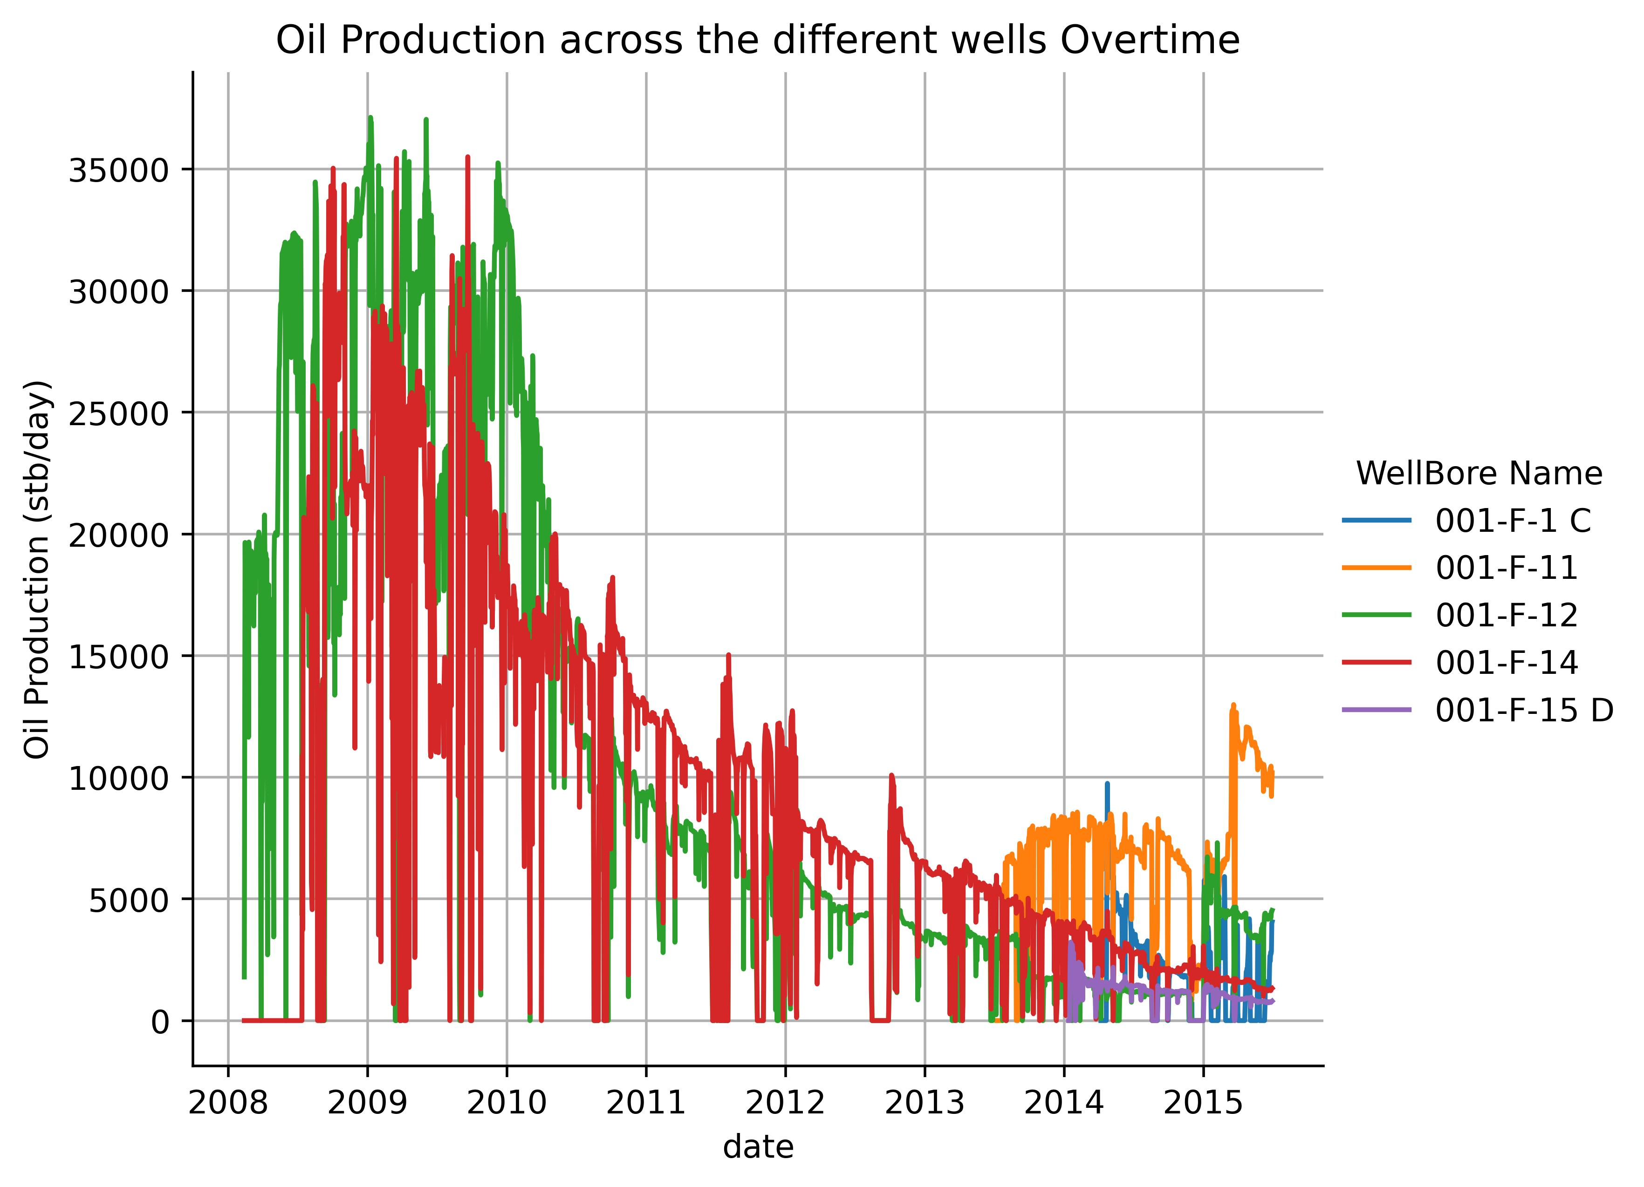
Brief Intro to Machine Learing
In Line with Problem – Brief Intro to TimeSeries in ML
Since the Problem involved Predicting “Future” production rates. It is best Categorized as a timeseries forecasting problem. Time series forecasting involves predicting future values based on previously observed data points collected over time.
Timeseries can be handled using various methods:
Timeseries models: These models use a window approach towards learning and there are specific models and algorithms for this purpose. E,g, Arima, Facebook Prophet, LSTM deep learning architecture, Recurrent Neural Network (RNN) architecture.
Timeseries as Supervised Learning: This involves extracting time related features such as day, year, week as features and also performing lag of features to use as new features with normal supervised learning models.

Slide 7
Machine Learning Flow
OVERVIEW
Data Cleaning
EDA and Outlier Removal
Feature Engineering
Data Splitting
Establishing Baseline (Gilberts Equation)
Modelling
Predictions

Slide 8

Machine Learning Flow
Data Cleaning and EDA
Consistency Check: Ensuring single name to denote a category e.g. a well having name in both upper and lower case in different rows.
DataType Confirmation: Numeric columns were changed to float datatype.
Handling Missing Values: Forward filling was employed to fill missing values.
Duplicates Check: Involved scanning for duplicate rows. No duplicate rows were found.
Insights from EDA
Category | Insight
Date | The Train data spanned 2008 – 2015
Well | 5 wells bores were given. With F-12 and F-14 having the oldest dates 0f 2008 (perhaps the oldest wells)
Gas-Oil Ratio (GOR) | Average GOR across all wells is 791.335

Slide 9

Machine Learning Flow
Feature Engineering
In line with handling timeseries as supervised learning, the below features were engineered towards better modelling;
1. Time based: Year, dayofyear, day, week.
2. Lag based: 1 to 5 days lag of Anulus pressure, choke size and well head pressure.
Data Splitting
Being a timeseries problem the data was split into training and testing in a sorted way as opposed to splitting randomly in non-timeseries problems.
The middle 12.5% and end 12.5% days for all wells were used as test data and the rest as training and validation during model tuning.

Slide 10
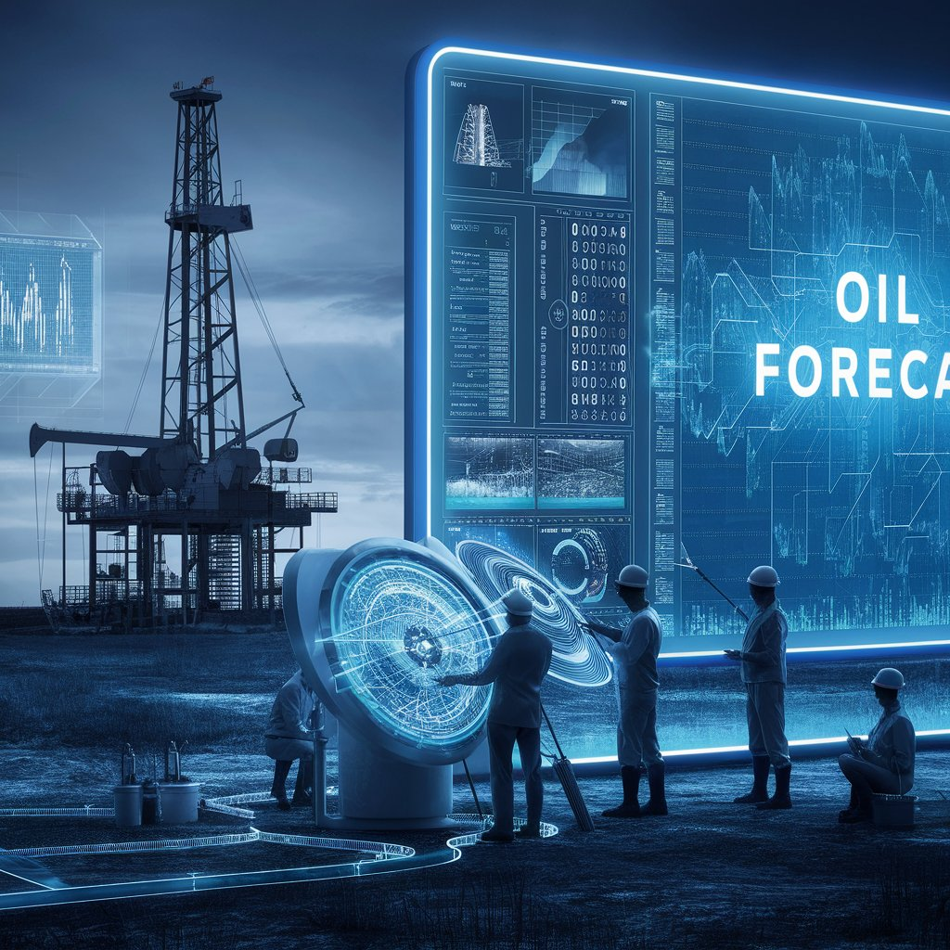


Prediction Results
Prediction Results
Total Historical Productions
Models Tested
SVR
Artificial Neural Network (ANN) (Used )
Model Tuning
- SVR was tuned using Bayesian optimization to find the best hyperparameters
- The ANN was tuned to find the best architecture (number of layers, learning rate, etc) and was saved. The ANN was seeded in prediction to ensure reproducibility.
WellBore Name | Oil Production (stb/day) | Gas Volume (scf/day) | Water Production (stb/day)
001-F-1 C | 903,421.13 | 747,540,025.13 | 625,605.79
001-F-11 | 4,877,046.79 | 4,113,850,478.09 | 1,266,428.29
001-F-12 | 28,006,034.73 | 22,870,038,821.08 | 39,963,852.90
001-F-14 | 24,443,457.60 | 20,096,495,901.37 | 37,634,006.58
001-F-15 D | 596,353.33 | 499,500,129.80 | 12,979.67
Total= | 58,826,313.58 | 48,327,425,355.45 | 79,502,873.22
Total Forecasted Productions
WellBore Name | Oil Production (stb/day) | Gas Volume (scf/day) | Water Production (stb/day)
001-F-1 C | 340,952.44 | 246,657,654.08 | 419,362.71
001-F-11 | 2,151,065.21 | 1,702,776,080.88 | 3,998,442.23
001-F-12 | 364,857.46 | 263,432,108.85 | 11,073,104.42
001-F-14 | 564,530.78 | 440,438,938.72 | 8,027,352.76
001-F-15 D | 230,265.23 | 150,216,928.98 | 455,991.34
Total= | 3,651,671.13 | 2,803,521,711.51 | 23,974,253.46

